Slide 1
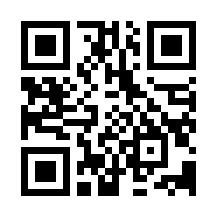
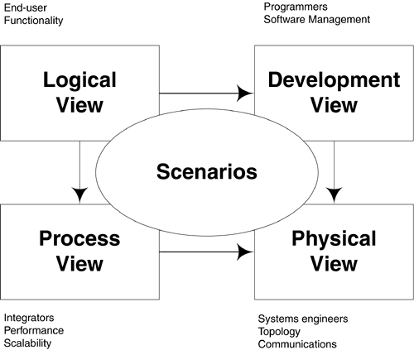
Introduction to Software Architecture Quiz
https://bit.ly/3mTdfHs

